Slide 1
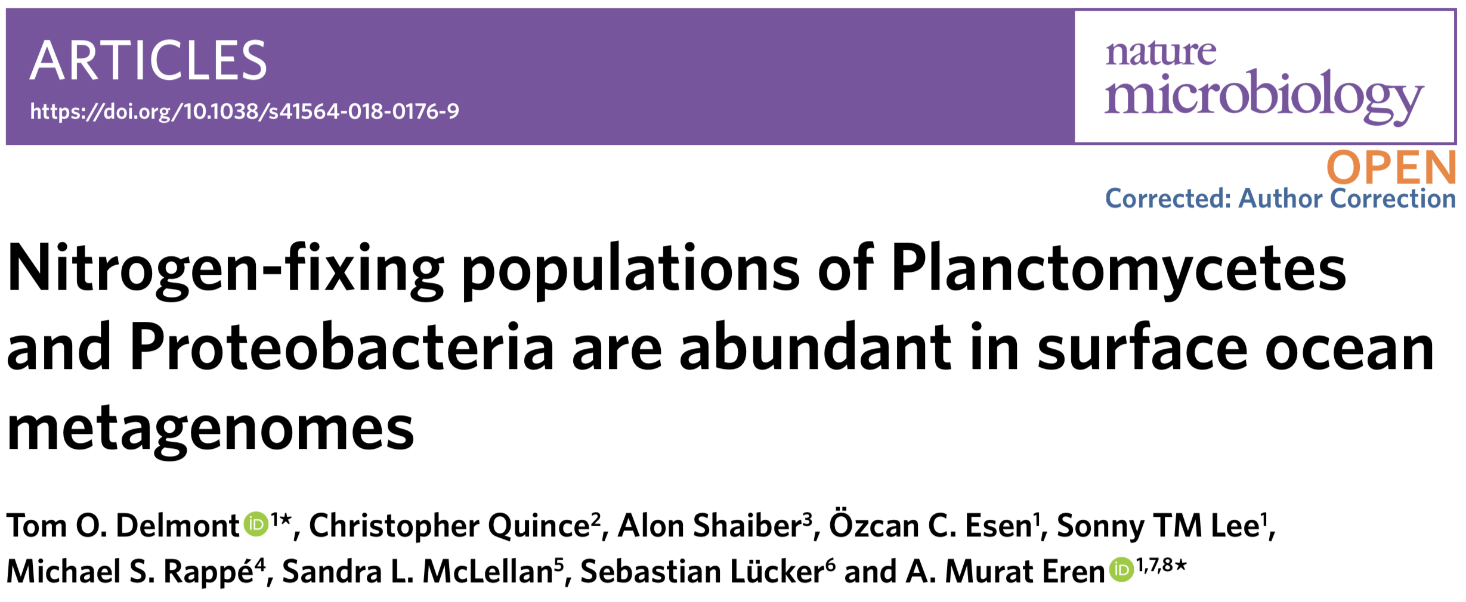
Data reanalysis by Emilie Skoog and Diana Dumit

Slide 2
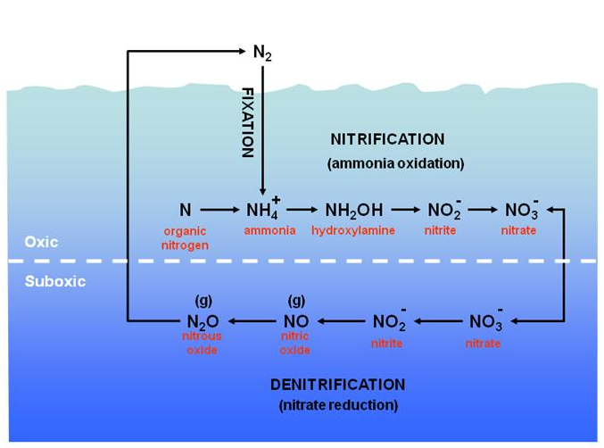
Nitrogen-Fixation
Mainly done by cyanobacteria and other non-cyano microbial populations
nif(D/H)

Slide 3
Figure 1 Pipeline
Generate anvio contigs database for each non-redundant MAG (958)
Retrieve and concatenate aa sequences using HMM profile
Create phylogenomic tree
View tree with overlaid taxonomy info
Create a text file mapping results
Create a text file with MAG taxonomy IDs

Slide 4
Figure 1 Issues
Anvio6 was a no-go
Had to start over in Anvio5
Used all non-redundant MAGs (~1000) instead of only Proteobacteria and Planctomycetes MAGs (~500)

Slide 5
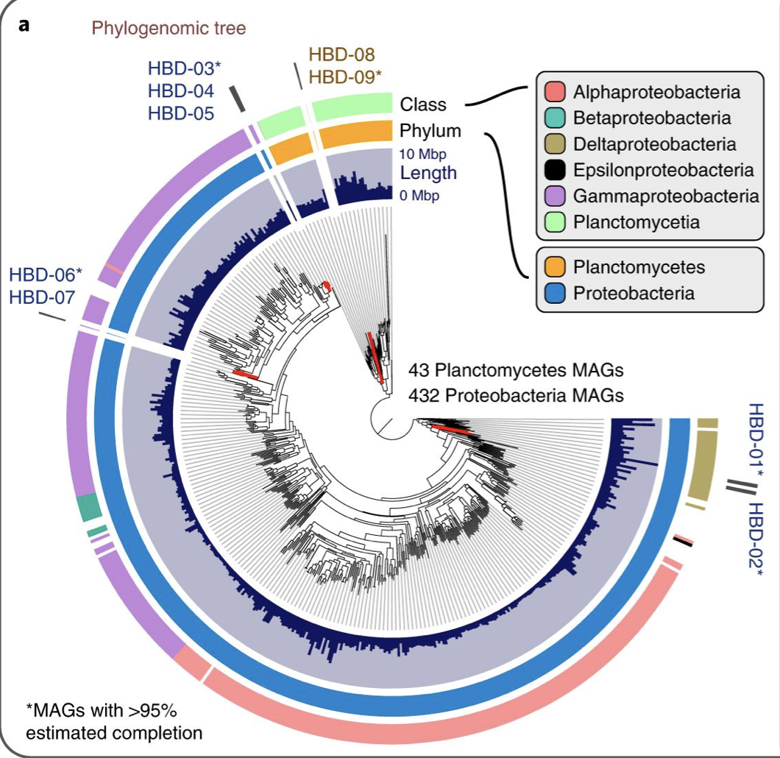
Figure 1 Comparison

Slide 6
Figure 2 Pipeline
Prepping for amino acid alignment
Alignment
Create phylogenetic tree
View tree
Merge all aa seqs for nifD and nifH independently
ClustalW
IQTREE
FigTree
Make database for HBDs
tBlastn to pull out top hits for nifD and nifH genes
Searching accession numbers in NCBI
Create fasta file with all aa seqs

Slide 7
Figure 2 Issues
Could not locate datafile with nifD and nifH amino acid sequences
Solution: pull accession numbers and locate aa seqs ourselves
Couldn’t use Phylosift
Did not have the identified nifD and nifH amino acid sequences in the HBDs
Solution: used tblastn for each HBD and manually pull out the top hit for nif genes
(ignored HBDs with top hit values greater than e⁻⁶ )

Slide 8
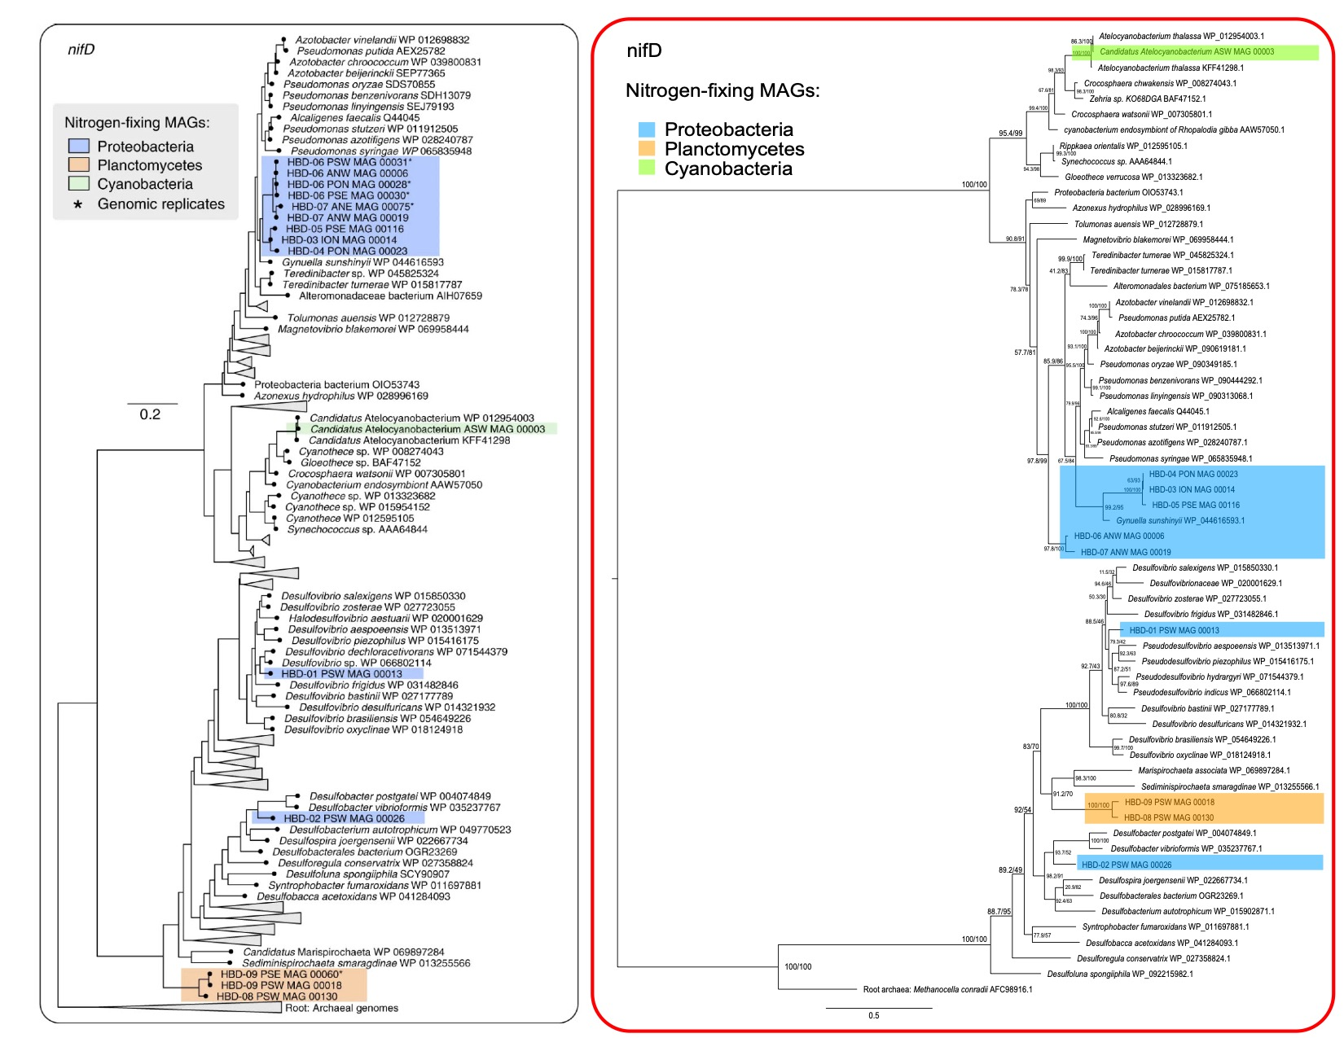
Figure 2 Comparison

Slide 9
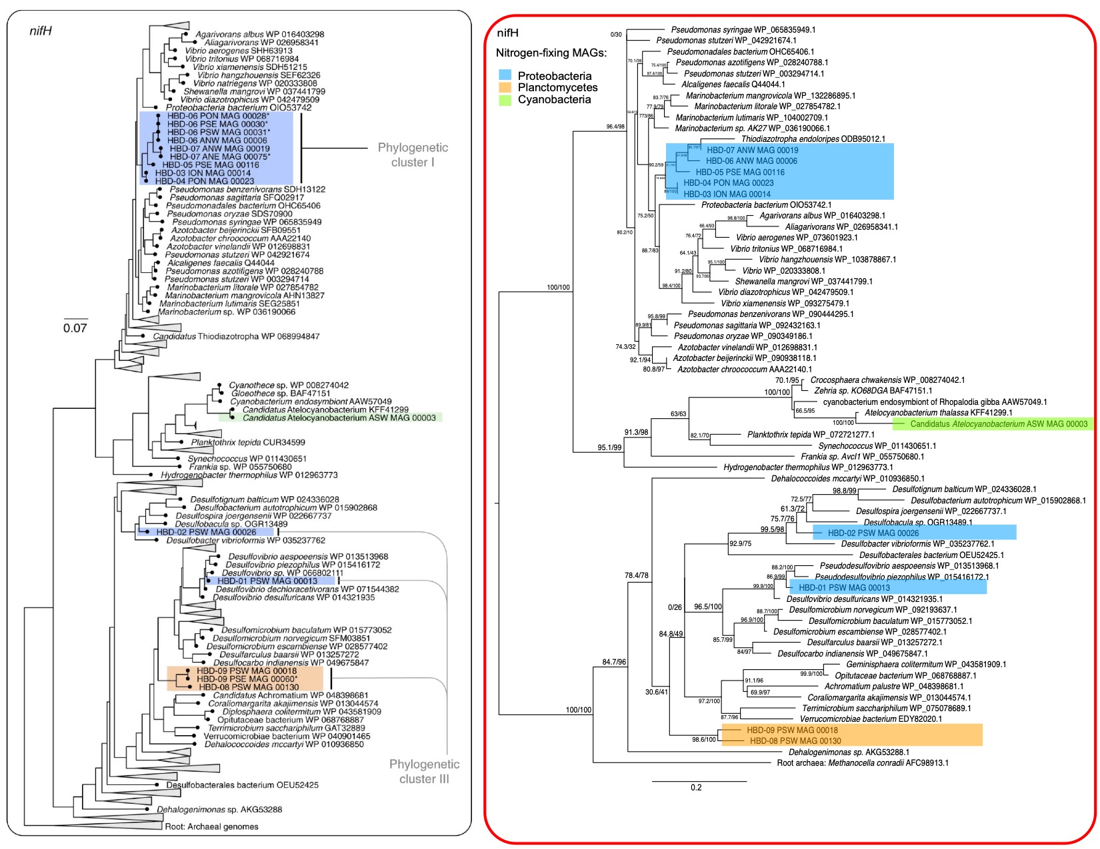
Figure 2 Comparison

Slide 10
Figure 3 Pipeline
Libraries used:
Pandas, mpl_toolkits.basemap
Import Basemap
Matplotlib.pyplot
Created background map for plotting using Basemap

Slide 11
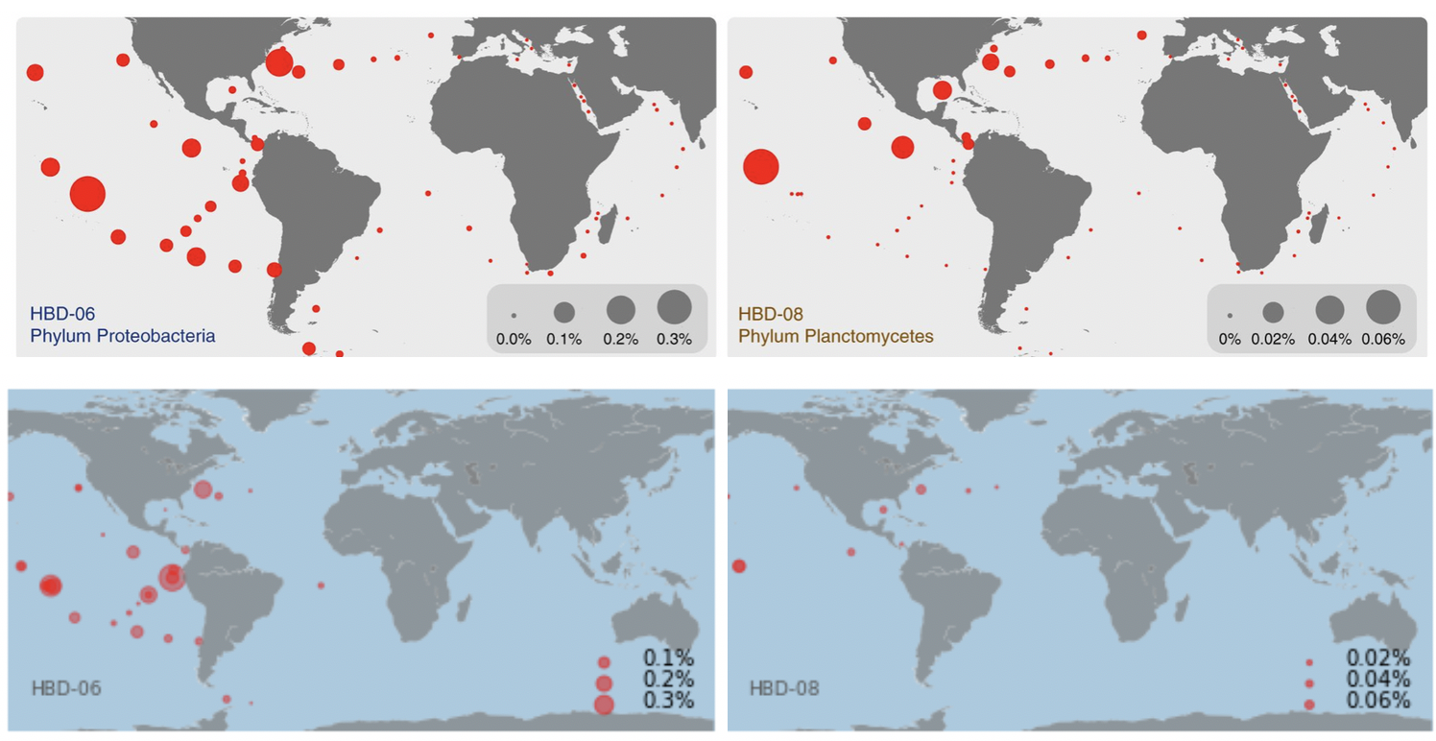
Figure 3 Comparison

Slide 12
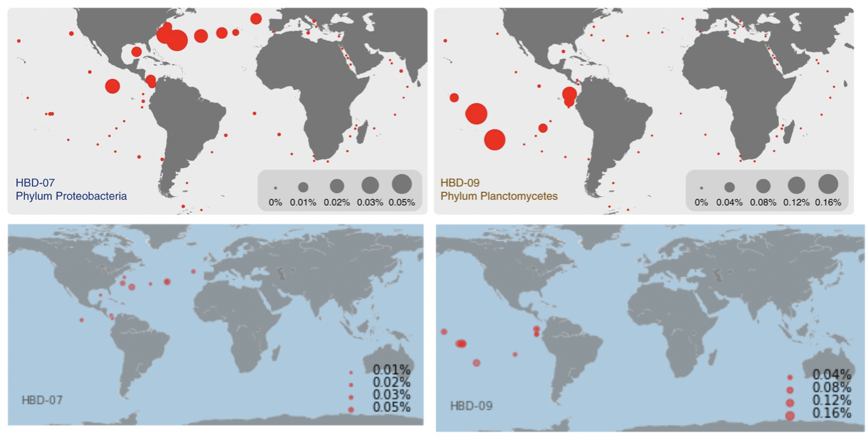
Figure 3 Comparison

Slide 13
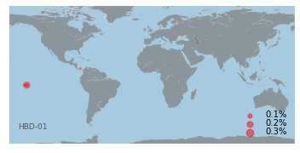
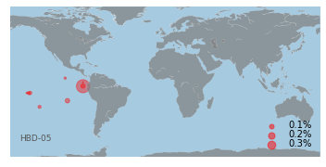


Extras!

Slide 14
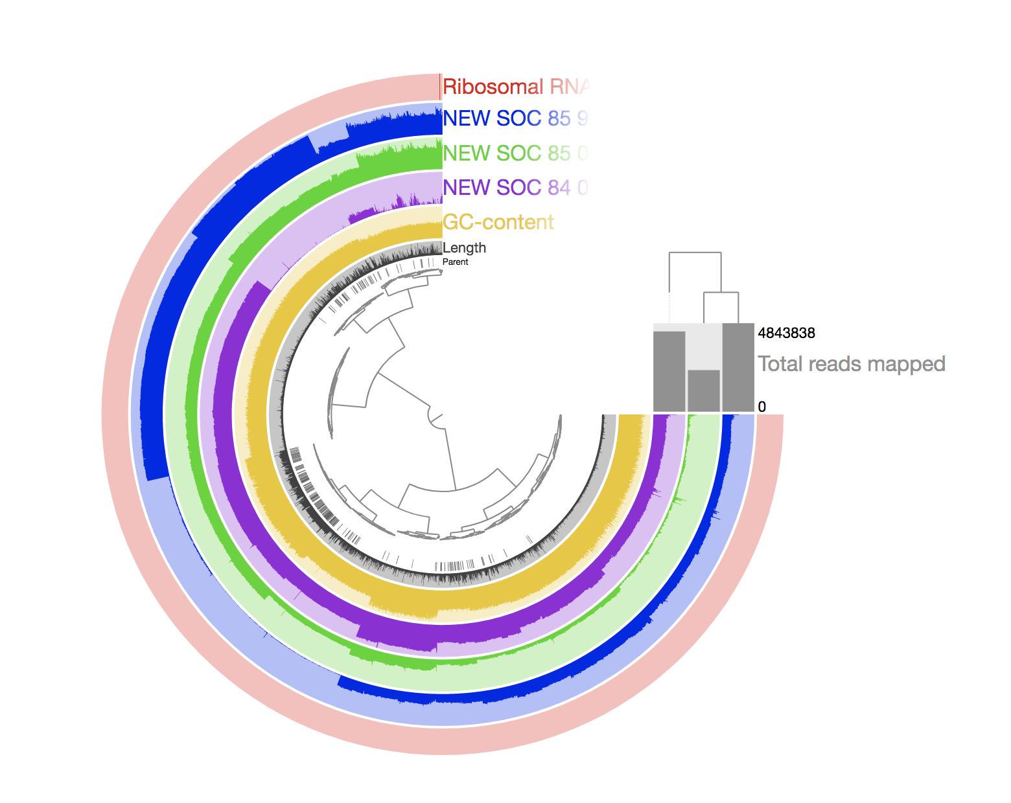
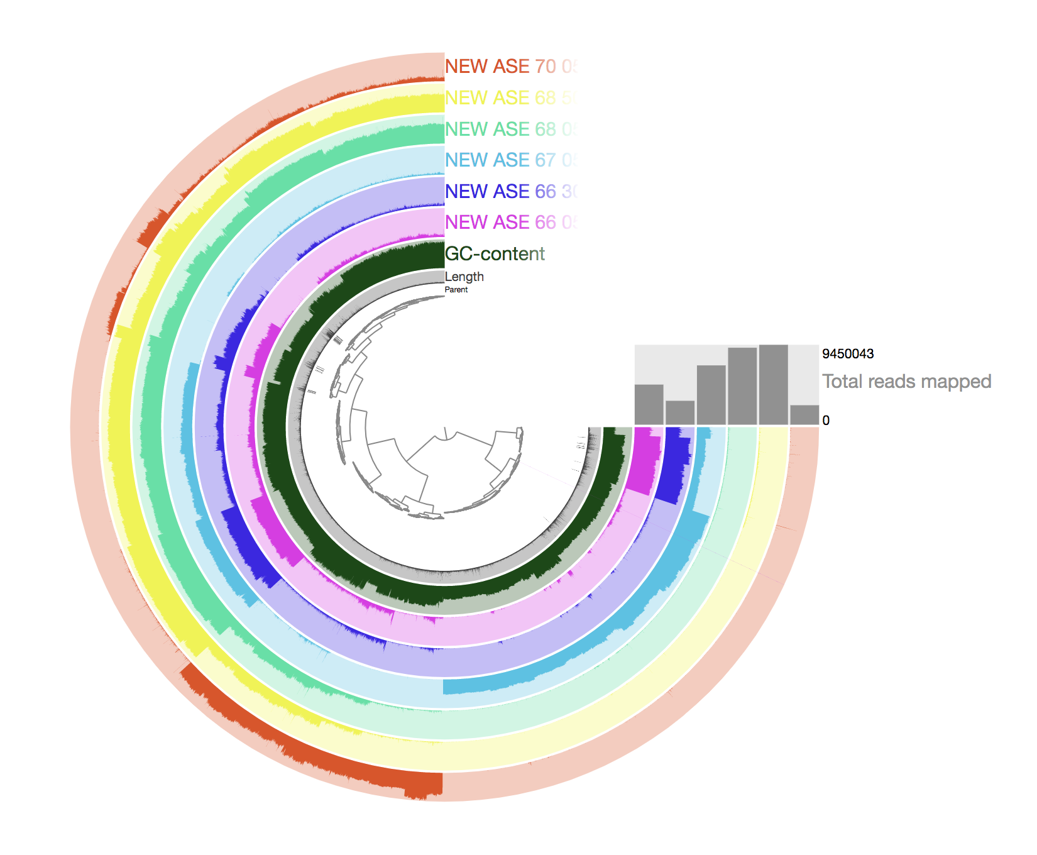
Visualizing MAGS from each of the 12 metagenomic sets

